Slide 1
Continuous Insulation for
Code-Compliant &
High Performance Walls
Notes:
Change title and presenter info to suit purpose. This presentation provides a comprehensive education on application of foam sheathing as continuous insulation.

Slide 2
Introduction

Slide 3
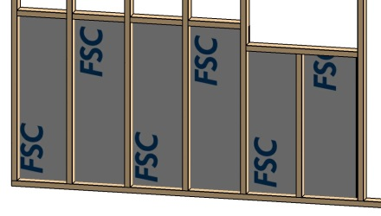
Introduction
Welcome
Scope:
  Above-Grade Exterior Walls
    Commercial and Residential Buildings
  Foam Plastic Insulating Sheathing (FPIS)
    Continuous insulation (CI) application
  Two audience groups:
    Builders, installers, inspectors & field sales staff
    Design professionals and plan reviewers
Notes:
Part 1 is a general overview of continuous insulation, functions, materials, and applications to provide a foundational understanding of continuous insulation for all building industry audiences. Parts 2 and 3 begin to focus on detailed matters of code compliance that must be considered to maximize the value of continuous insulation and ensure its appropriate use. Links to practical resources are provided for designers, code officials, builders, and installers.
Why consider pros and cons?
There’s no perfect product
The market makes decisions based on pros and cons
Competitors focus only on cons (which sometimes are actually pros)
Buyer’s & users appreciate good, unbiased information
Credibility when you respond to questions and concerns
3

Slide 4
Outline
Three Parts:
  PART 1: Continuous Insulation
    Definition, types, properties, functions, applications
  PART 2: Energy Code & CI
    Wall insulation and air-barrier requirements, code compliance resources, and non-equal substitutes
  PART 3: Building Code & CI
    Fire safety, structure, vapor retarders, water-resistive barrier and code compliance resources

Slide 5






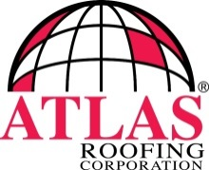
Who is FSC and ACC?
The Foam Sheathing Committee (FSC) of the American Chemistry Council focuses on technical research and education to advance the appropriate use of foam sheathing and promote its application in codes, standards, and other resources for the construction industry.
Current Regular Members Are:
  Atlas Roofing
  Dow
  GAF
  Hunter Panels
  Johns Manville
  Owens Corning
  Rmax

Slide 6
Overview

Slide 7
Why learn about Continuous Insulation?
A well-informed market is a successful and sustainable market
Designers, builders, code officials, and installers need:
  Access to good information to guide decisions in the appropriate use of continuous insulation.
  Resources to help comply with code requirements and identify optimal solutions, including:
    Literature research, testing, analysis and code defined Research Reports
    Code compliance Research Reports
    Installation details
    Manufacturer instructions
    Educational programs
  To gain experience and confidence to maximize CI’s:
    Cost-effective use
    Various benefits and capabilities.
Notes:
This lists some of the reasons why learning about Ci might be important. This may begin to sound like a sales pitch, but at some point information is need to make a good decision and that information should come from credible sources.

Slide 8
Benefits & Capabilities of CI
  Energy Code Compliance:
    A simple and effective solution to prescriptive R-values in colder climate zones
    An effective alternative in any climate zone.
  Above-Code Performance:
    More CI = enhanced thermal and moisture control
    Increasing cavity insulation only to meet energy code can increase risk of moisture condensation, unless other mitigating actions are considered.
Notes:
First, you must be aware at least in a general sense of what the benefits and capabilities of CI are to be able to most effectively use them or even consider using CI. The following slides give a summary overview of some of the key benefits of considering the use of continuous insulation on a building project. The code-compliant application of these various benefits and capabilities will be demonstrated mainly in Parts 2 and 3 of this presentation.

Slide 9
Benefits & Capabilities of CI
  Resource and Environment Conservation:
    CI reduces energy consumption and greenhouse gas emissions over the life of the product and building
  Economic Payback:
    Investment in CI is paid back throughout the life of the building with reduced energy use

Slide 10
Benefits & Capabilities of CI
  Occupant Comfort:
    CI can provide a more comfortable interior environment because it isolates the structure and interior from outdoor extremes and helps minimize cold-spots (thermal bridges).
  Durability:
    CI protects structural materials and interior finishes from excessive moisture and temperature extremes, prolonging life expectancy and reducing risk of “call-backs”

Slide 11
Benefits & Capabilities of CI
  Multi-Functional:
    CI can be used as a cost-effective 4-in-1 solution for:
      Continuous insulation
      Continuous air-barrier system
      Water-resistive barrier system
      Water vapor control layer
    This 4-in-1 performance of CI is often associated with the concept of a “perfect wall” for high-performance buildings, yet the same principles can be used for minimum code wall assembly.
      Some proprietary CI products can provide structural bracing (a 5th capability)

Slide 12
Execution
Like most building products, the benefits of CI depend on proper execution in design and installation.
CI needs to be properly integrated with the energy code, building code and components for a complete wall assembly.
Fortunately, there are excellent resources to help the user succeed.
Notes:
We will get into the resources and solutions in Parts 2 and 3 of this presentation.

Slide 13
Outline
Notes:
Presenter can edit the outline to match the modules he/she has chosen for the presentation.

Slide 14
Topical Outline
PART 1 – Continuous Insulation Primer
  Definition
  History of CI
  Integrated Role of CI in Building Construction
  Energy Conservation and Environmental Value of Continuous Insulation
  Types & Properties of CI Materials
  Overview of Multiple Functions & Applications of CI
  Resources for Code Compliance and Technical Support (tabulation with code references and TER references/links)

Slide 15
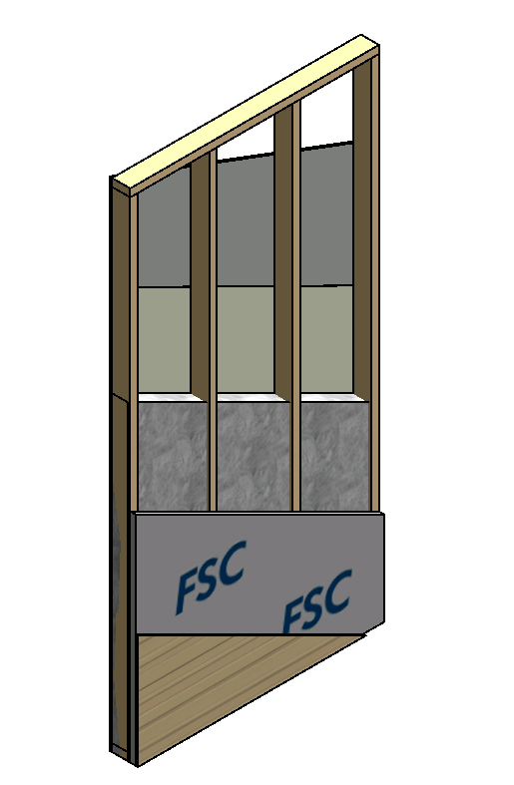
Topical Outline
PART 1a – Foam Sheathing Applications For All Climate Zones
  1-2
  3-4
  5-6
  7-8

Slide 16
Topical Outline (cont’d)
Part 2 – Energy Code Compliance
  Importance of Energy Efficiency and CI
  Multiple Paths for Compliance
  Three Wall Insulation Methods
  Wall insulation requirements
    Prescriptive R-values (IECC-C or ASHRAE 90.1)
    Prescriptive R-values (IECC-R / IRC Chapter 11)
    U-factors for alternative insulation strategies
      Calculator for U-factor alternatives with CI (pending)
    Application of whole building UA analysis
    Energy Rating Index and Performance Path

Slide 17
Topical Outline (cont’d)
Part 2 – Energy Code Compliance
  Cautions:
    Ensure accurate calculation of thermal performance
    Avoid excessive thermal trade-offs in whole building UA analysis
    Check moisture performance
    Use CI to control moisture vapor and maximize inward drying potential.
    Avoid thermal bridging through details that short-circuit continuous insulation

Slide 18
Topical Outline (cont’d)
PART 3 – Building Code Compliance
  Fire Safety
    Requirements for CI
      Type I-IV buildings
        Reference TER No. 1202-04
      Type V buildings
        Reference TER No. 1202-03
    NFPA 285
      Type I-IV buildings
        Reference TER No. 1202-01

Slide 19
Topical Outline (cont’d)
PART 3 – Building Code Compliance
  Structural Components
    Sheathing
      Reference code requirements IBC 1403/IRC R703
      Reference ANSI/SBCA FS100
    Cladding Attachment
      Reference code requirements IBC 1609/IRC R703.1.2
      Reference TER No. 1303-04 (attachments)
      Reference TER No. 1205-05 (details)
    Window Attachment
      Reference code requirements IBC 1405.13/IRC R612.7
      Reference TER No. 1304-01

Slide 20
Topical Outline (cont’d)
PART 3 – Building Code Compliance
  Structural Components
    Vinyl Siding Wind Pressure Rating
      Reference code requirements IBC 1405.14 /IRC R703.1.2
    Foam behind PC Stucco (IBC 2510.6 and IRC R703.2)
      Explain use of exception to justify foam sheathing behind PC stucco
      Reference TER No. 1303-04
      Reference TER No. 1205-05

Slide 21
Topical Outline (cont’d)
PART 3 – Building Code Compliance
  Structural Components
    Foam behind wood shingles/shakes (IRC R703.5)
      Mention BC Cedar Shake & Shingle Guide as alternative for single layer furring
      Refer to use of drainscreen products as alternative to furring
      Show FSC case study report with no furring
      A single layer of furring is the recommended minimum practice unless the wall is completely shielded from weather – e.g., under porch roof, etc.
      A double layer of furring appears most applicable in only the most severe climates (e.g., > 800 mm/yr horizontal rainfall, or on walls in milder climates with limited protection by roof overhangs.

Slide 22
Topical Outline (cont’d)
PART 3 – Building Code Compliance
  Structural Components
    Bracing
      Reference code requirements (IRC R602 / IBC 2308)
      Reference FSC guide and ICC guide and APA guide
        Recommendations and guidelines
      Many builders are using a building designer or engineer for bracing code compliance.

Slide 23
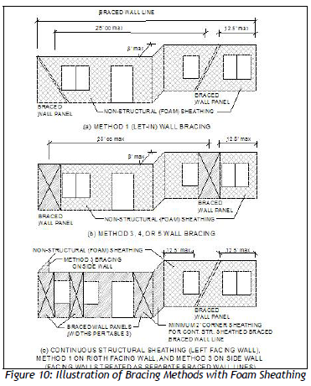
Topical Outline (cont’d)
PART 3 – Building Code Compliance
  Structural Components
    Bracing
      Foam sheathing integration

Slide 24
Topical Outline (cont’d)
PART 3 – Building Code Compliance
  Moisture Control
    Water resistive barrier (WRB)
      Reference code requirements (IBC 1404.2 /IRC R703.2 2015)
      Reference WRB TER No. 1410-05
      Installation detail TER No. 1205-05
        Refer to manufacturer’s specific code compliance research report and details
        Do not make component substitutions unless specifically permitted by the manufacturer
        Be very careful of “or equal” specifications
        Routinely inspect and verify installation of flashing and sealing components.

Slide 25
Topical Outline (cont’d)
PART 3 – Building Code Compliance
  Moisture Control
    Air-Barrier (just to mention importance of this items to moisture vapor control, even though it is addressed in energy code)
    For more about Air-Barriers refer to energy code Part 2

Slide 26
Topical Outline (cont’d)
PART 3 – Building Code Compliance
  Moisture Control
    Integrated vapor retarder and insulation strategies
      Reference code requirements
        2012 IBC 1405.3/IRC 702.7,
        2010 NBCC Subsections 5.5.1 and 9.25.4
      Reference ABTG Research Report (pending)
      Illustrate determination of acceptable solutions
      Coordinate with energy code R-value or U-factor requirements
      Recommend that insulation ratios should be considered in CZ 4 or higher any time exterior sheathing and other exterior components have a net perm < 5 perm.
      Recommend exterior low perm in moist/humid climates CZ 1 and 2 and CZ 4C (marine) with high perm interior (Class III)

Slide 27
Topical Outline (cont’d)
PART 3 – Building Code Compliance
  Cautions:
    Beware of false claims about moisture performance
      Ex. EIFS
      Ex. Must dry to the exterior
    Be sure adequate indoor RH control (ventilation in north, dehumidification in south) is provided for any moisture control strategy.

