Slide 1
Continuous insulation primer

Slide 2

PART 1 – Continuous Insulation
Definition (ASHRAE 90.1)
Applications: Roof, Wall, and Foundations

Slide 3
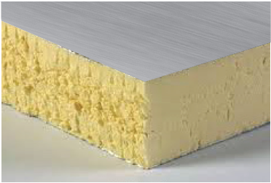
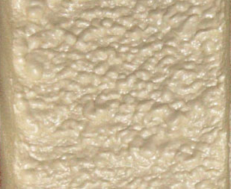
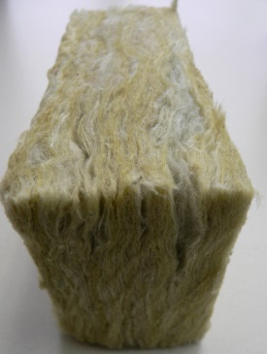
Kinds of Continuous Insulation
Foam Plastic Insulating Sheathing
  EPS, XPS, Polyiso
Spray Polyurethane Foam
  SPF (closed cell polyurethane)
Others
  Rock wool
  Fiberglass boards
  Fiberboard
Notes:
A brief overview of the different kinds of Continuous Insulation. Each has pros and cons in terms of capabilities and properties. The scope of this presentation focuses on foam plastic insulating sheathing.

Slide 4
CI History & Experience
In early 1900’s, solid wood board sheathing was considered as a form of continuous wall insulation (HEW, 1931) (~1.2 R/in)
Cellulosic Fiber Insulating Board (‘Fiberboard’) is a form of continuous insulation in use since the early 1900’s (~2.5 R/in)

Slide 5
CI History & Experience
Continuous insulation is not a new concept. Foam plastic insulating sheathing has been successfully used in this application for more than 50 years.
  Foam sheathing has been used as continuous insulation for low-slope roofs since the 1940’s (~4-6 R/in)
  Wall applications of continuous insulation saw increased interest after the 1970’s oil crisis

Slide 6
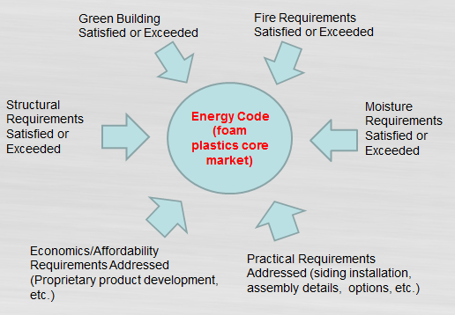
Role of CI and Various Requirements for Appropriate Use
Notes:
6

Slide 7
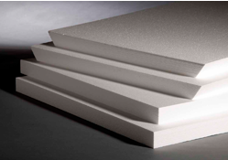
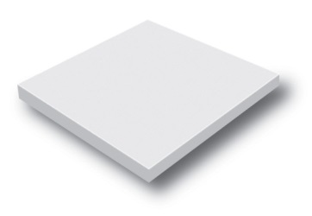

Foam Plastic Insulating Sheathing (FPIS)
Expanded Polystyrene (EPS), ASTM C578
Extruded Polystyrene (XPS), ASTM C578
Polyisocyanurate (Polyiso), ASTM C1289

Slide 8
R-value per Inch
Consult with FPIS manufacturer for specific values.
Values shown are representative minimum values.
Notes:
Rigid foam plastic sheathing materials are commonly used for continuous insulation because of their relatively high R-value per inch and low cost to meet or exceed energy code requirements
8

Slide 9
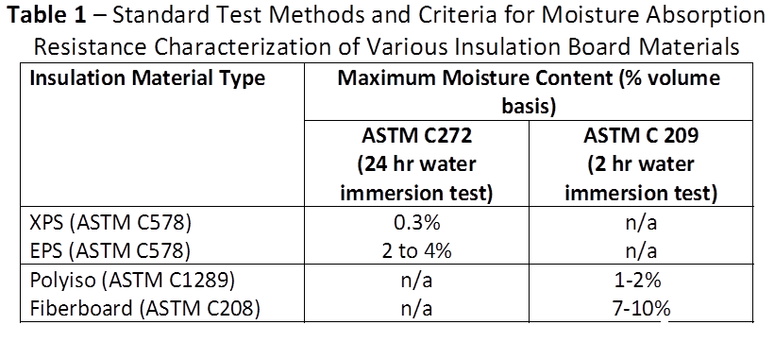
Water Resistance
Notes:
XPS, EPS, and Polyiso have relatively stringent water absorption resistance requirements to satisfy a variety of applications; refer to ASTM standards for variations by type.

Slide 10
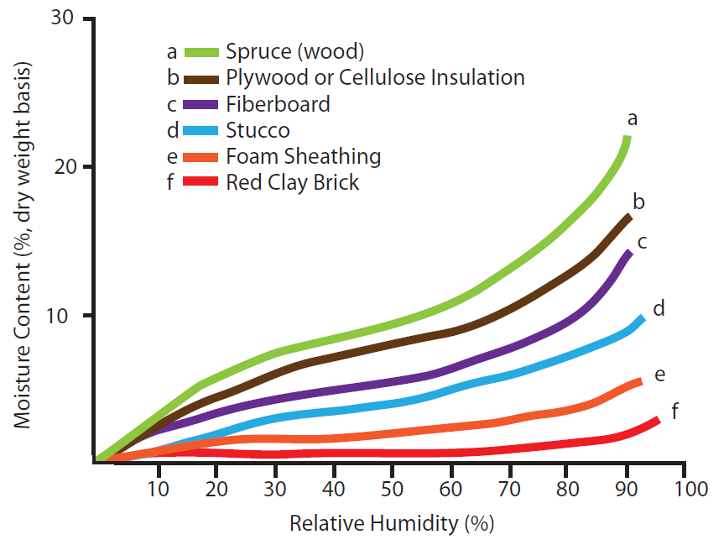
Moisture Sorption Comparison
XPS, EPS, and Polyiso all have a lower tendency to adsorb moisture than many other common building materials.
Notes:
10

Slide 11
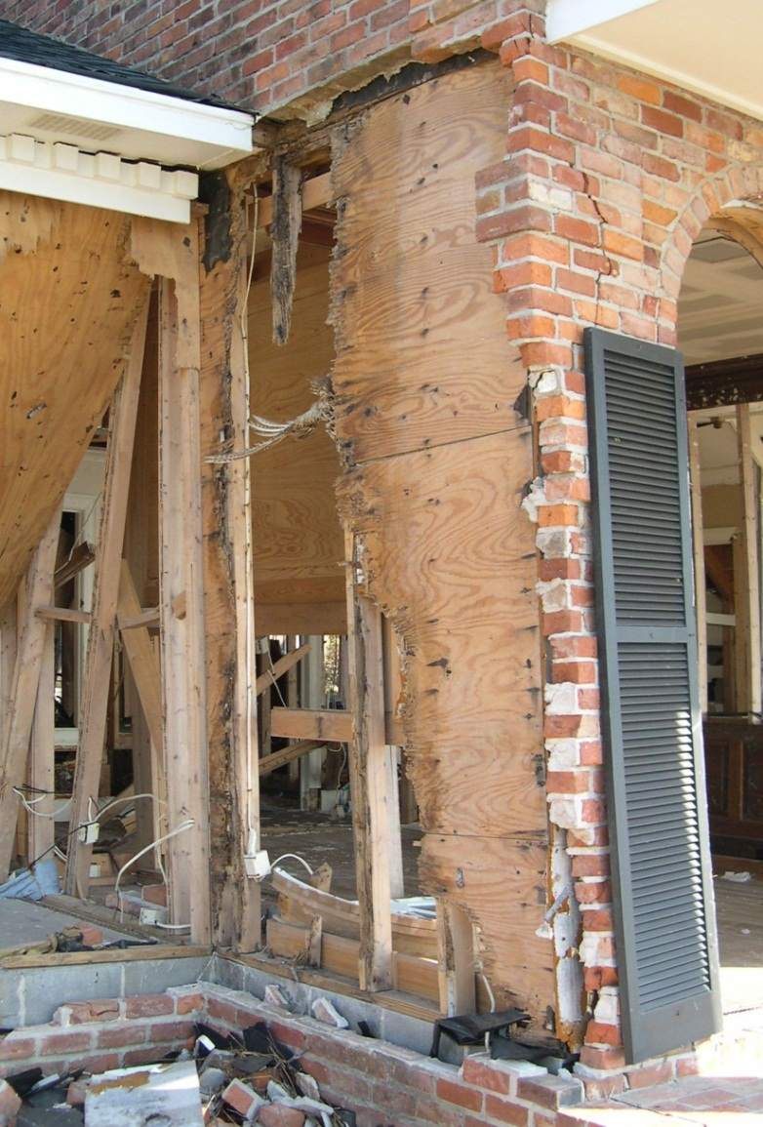
Durability
Foam Plastic Insulating Sheathing (FPIS)
  Does not rot, decay or corrode
  Not food for termites
  Can be used to protect moisture sensitive sheathing and framing materials
Other wall sheathing
  May be prone to moisture damage without adequate protection
Notes:
FPIS
Does not rot, decay or corrode like some other building materials.
Other common wall sheathing materials are prone to moisture damage, such as rot and degradation, if they are not protected by proper flashing and water-resistive barrier application.
11

Slide 12
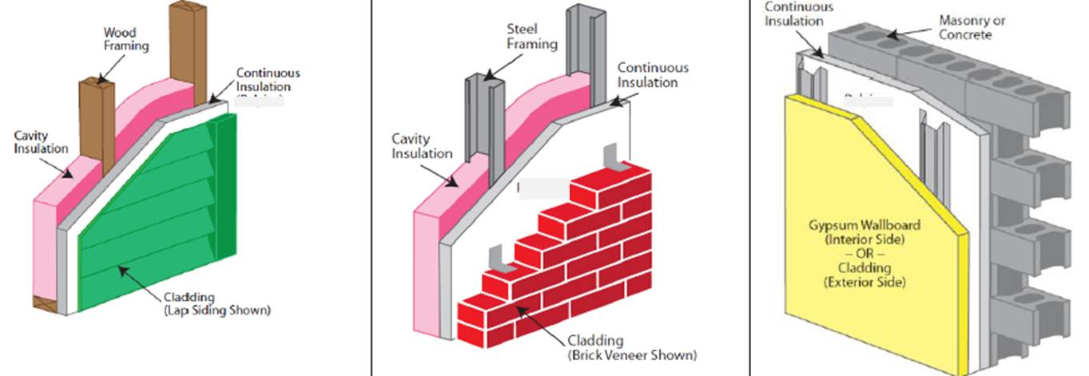
Wall Applications
Adaptable to a variety of exterior wall construction types, cladding types, and building types

Slide 13
Wall Functions of CI
Continuous Thermal Insulation (CI)
Water Resistive Barrier (WRB)
Air Barrier (AB)
Water Vapor Control (WVC)
  The code compliant application of the above functions will be covered later in this presentation

Slide 14
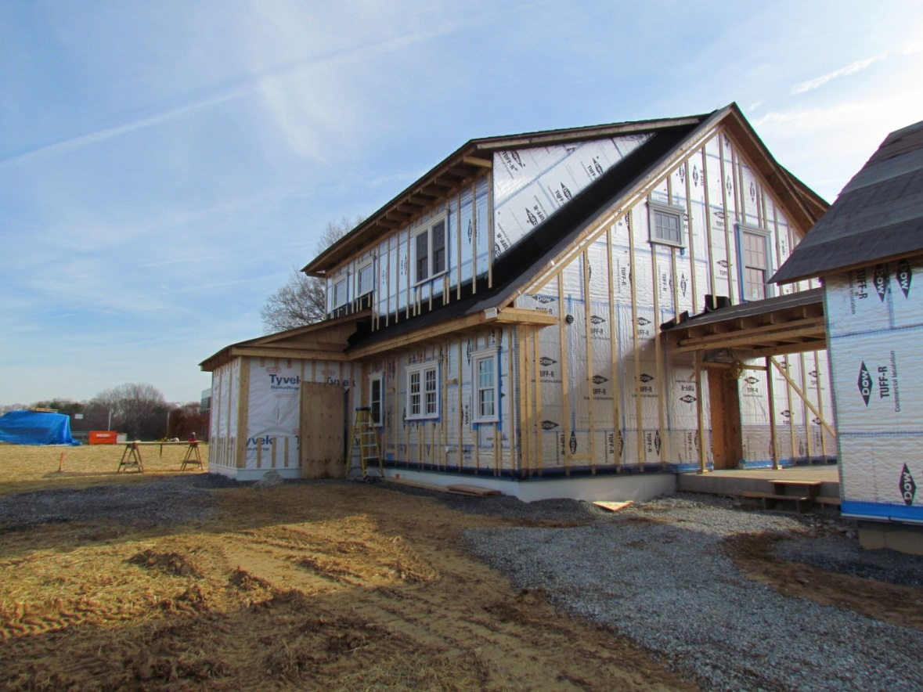
Going beyond minimum code with CI
Zero Energy
WRB
AB
WVC
Building Science Corporation
NIST Net Zero Energy Research Home
Notes:
As shown in this photo, FPIS is not just a minimum code insulation solution. It can reach far beyond minimum code requirements to provide exceptional energy savings while providing protection to the building system as a water-resistive barrier, air-barrier, and vapor control layer.
Thus, it is frequently use to gain approval in above-code energy efficiency and green construction programs, such as Energy* and LEED.

Slide 15
Topical Resources for Parts 2 & 3
Topic | Resource (link)
U-factor | http://appliedbuildingtech.com/calculator.html
Fire | TER No. 1202-01, TER No. 1202-03, TER No. 1202-04
Bracing | TER No. 1410-07 (not online yet)
Air Barrier | TER No. 1410-06
WRB | TER No. 1410-05
Vapor Control | TER No. 1309-02 (not online yet)
Wind Pressure | ANSI/SBCA FS100-12
Detailing | TER No. 1205-05
Air-space R-value | Tech Matters - Energy Code Compliance: Thermal Resistance of Air Spaces Behind Exterior Wall Coverings
Termites | Tech Matters – Analysis of and Recommended Actions for Termite Related Code Change Proposals for the 2012 IBC & IRC
Vinyl Siding Over Foam | TER No. 1006-01 (pending updates)

