Slide 1
Energy codes intro

Slide 2
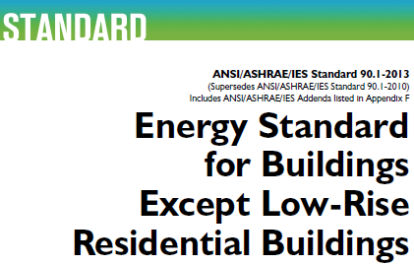
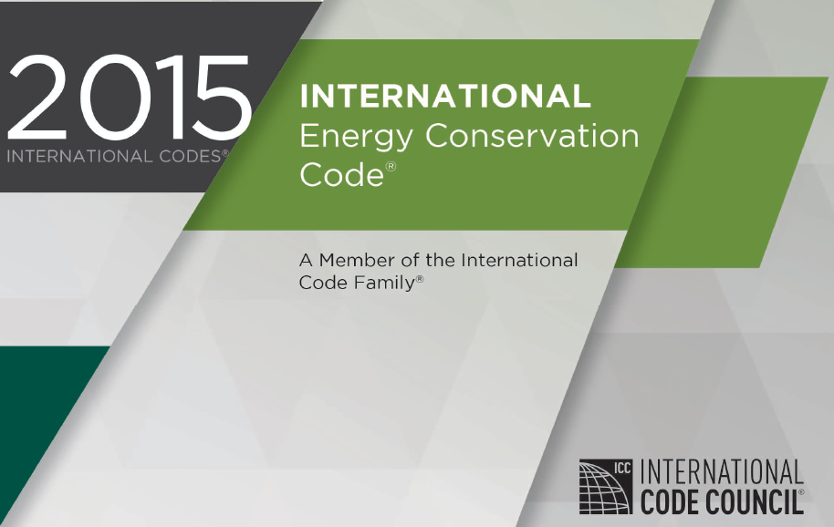

PART 2 – Energy Code Compliance
Two primary sources for requirements plus IRC Chapter 11 for One-/Two-Family Dwellings.
www.icc-safe.org
www.ashrae.org
This presentation focuses on IECC provisions. Use of CI
for compliance with ASHRAE 90.1 is similar.
Notes:
In the 2015 I-codes, the IRC Chapter 11 and IECC Residential provisions are unified. NOTE: It is very important to check which edition of the code is being used locally before drawing conclusions about requirements. In addition, there may be local amendments, particularly for wall insulation requirements which have been the focus of misinformed attempts to water down the long-term, durable energy efficiency of building envelope insulation levels. Often, misguided or incomplete technical arguments are made to support the roll-back of model energy code insulation requirements or create non-equivalent loopholes and trade-offs. These issues will be discussed at the appropriate time as we move through the subject matter of this presentation which has the primary focus of doing things right – but necessarily having to expose some non-equivalent competitive tricks primarily intended to give advantage to other materials and methods than ci. Unfortunately, we have to recognize that there is much trickery going on in the market and at local, state, and national code development levels. But, recent model codes have resolved many of these issues, assuming they are actually adopted without modification.

Slide 3
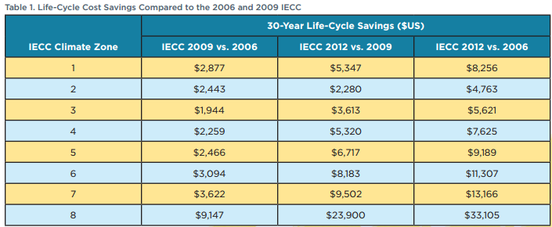
Why Energy Conservation?
Even small improvements can have a big impact
  Significant life-cycle cost savings over a 30-year period
  Methodology considers energy savings, initial investment financed through increased mortgage costs, tax impacts, and residual values of energy efficiency measures
Notes:
When it comes to energy conservation, even small improvements on a large scale can have a big impact on resources and the environment.
Recent energy code improvements, including the use of continuous insulation, can have a break-even mortgage cost in as few as 10 months,
Allowing homeowners to pay down their mortgages faster.
For example, see the DOE report, National Energy and Cost Savings for New Single– and Multifamily Homes: A Comparison of the 2006, 2009, and 2012 Editions of the IECC.
http://energy.maryland.gov/codes/documents/NationalResidentialCostEffectiveness.pdf
From Department of Energy (DOE):
“Life-Cycle Cost: Full accounting over a 30-year period of the cost savings, considering energy savings, the initial investment financed through increased mortgage costs, tax impacts, and residual values of energy efficiency measures”
“Life-cycle cost is the primary measure by which DOE assesses the cost-effectiveness of the IECC. These savings assume that initial costs are mortgaged, that homeowners take advantage of the mortgage interest deductions, and that long-lived efficiency measures retain a residual value after the 30-year analysis period. As shown in Table 1, life-cycle cost savings are substantial in all climate zones.”

Slide 4
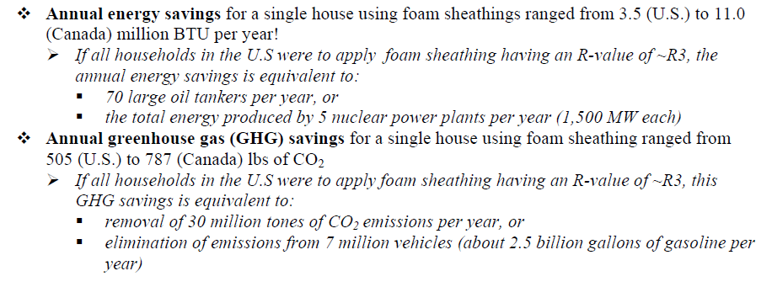
Energy Conservation and Environmental Value of CI
Even small improvements on a large scale can have a big impact on resources and environment:
Recent energy code improvements, including use of CI, can have a break-even mortgage cost in as few as 10 months; consumers can then use the savings to pay down their mortgages faster (ICF Int’l study for BCAP).

Slide 5
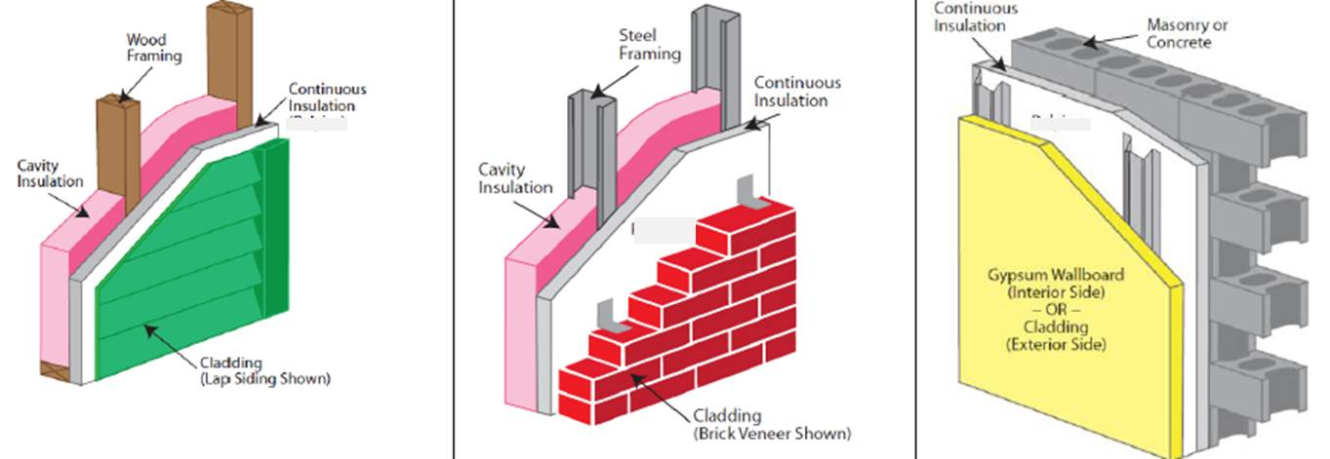
Three Basic Approaches for Insulating Light-Frame Exterior Walls
Cavity insulation only (traditional method)
Cavity insulation + continuous insulation (common choice for high-performance frame walls and minimum code in colder climates)
Continuous insulation (ci) only (common for masonry/concrete walls, provides “warm wall” approach to frame walls & minimizes thermal bridging)
In general, CI is most effectively located on the exterior side of an exterior wall to provide better protection of the building and avoid thermal bridging.
Notes:
There are actually several options with different performance properties (thermal and moisture control) for cavity insulation only walls. The cavity insulation may be air- or vapor permeable (e.g., fiberglass and cellulose and open cell spray foam) or air/vapor impermeable (SIPs panels with rigid foam core or closed cell spray foam partial or complete fill of cavity). Similarly, continuous insulation can accommodate a variety of options depending on climate zone and type of construction and desired combination with cavity insulation, if any. The energy code makes all of these solutions possible, however, only a few of the preferred or representative R-value prescriptive solutions are included directly in the code to avoid having hundreds of solutions listed in the code.

