Slide 1
Prescriptive R-values, U-factor equivalents, and total ua analysis

Slide 2
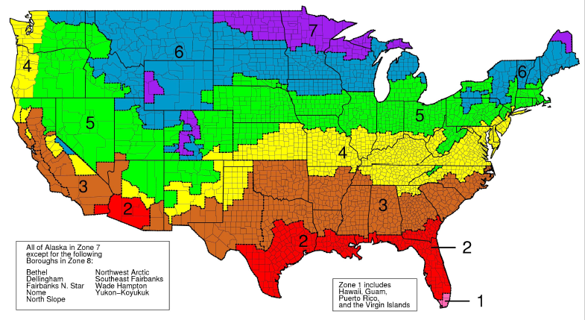
US Climate Zones
US Climate Zone Map (PNL/DOE interactive map)
Notes:
Energy code requirements and thus wall insulation amounts vary by climate zones. Generally, more insulation is required as one moves north because otherwise heating energy consumption and cost would increase dramatically.

Slide 3
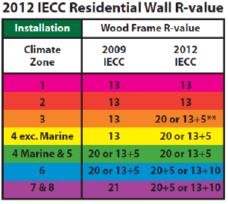
Prescriptive Wall R-values – Homes
2015
IECC
(same as
2012 IECC)
Notes:
Prescriptive R-values are the simplest path to compliance with the energy code. But, they are not always the most cost-effective. Thus, the code provides other pathways to consider alternative solutions. These will be addressed later. For now, note that continuous insulation is prominently featured as a prescriptive solution or option (e.g., R13+5ci, R20+5ci, and R13+10ci). It is important to also note that a 2x4 wall with a typical 1” of ci (e.g., 13+5) is shown as an alternate or equivalent to a 2x6 R20 cavity insulation only wall. This shows that ci is a more efficient insulator and thinner net wall assemblies with ci can provide equivalent or better thermal performance than thicker walls with cavity insulation only.
Prescriptive solutions are based on R-values of insulation components (cavity and ci), not the actual R-value of the completed assembly. This is addressed through U-factors to determine equivalent alternatives.
3

Slide 4
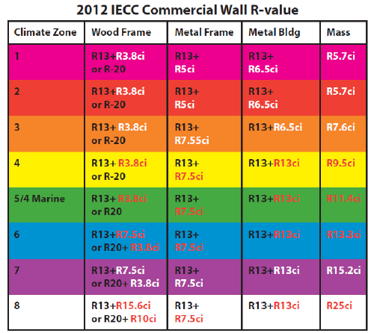
Prescriptive Wall R-values – Commercial Buildings/Non-Res
Note that the use of CI is featured in all climate zones for all building types.
Again, equivalent alternatives are possible through the U-factor approach.
Residential apartment/condo values may be slightly higher in some climate zones
2015 IECC – same as 2012 IECC

Slide 5
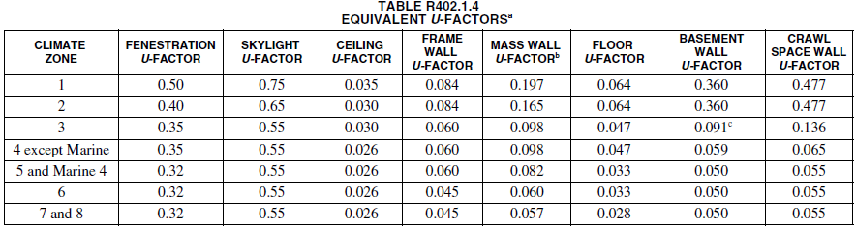

U-factors for Equivalent Alternatives to R-values
Table R402.1.4
Above table for homes. U-factors for commercial buildings will differ; See IECC-C and ASHRAE 90.1
Notes:
This U-factor table is for homes and these U-factors are consistent with the prescriptive R-values which is based only on describing the insulation components. The U-factor takes into consideration the contribution of all building materials to the thermal performance of a wall. The U-factor measure heat conduction and the inverse of heat condition is heat resistance or R-value. Except this is the real or total or effective R-value of the whole assembly, not just the materials that are declared to be insulation. All materials, and even air-films on either side of a wall, contribute to thermal performance.

Slide 6
Application of the U-factor
Use this approach to:
  Explore alternatives to the prescriptive wall insulation (more CI and less cavity R-value, etc.)
  Determine U-factor input to energy model or energy rating programs
Must use code-compliant insulation materials
Must substantiate U-factor for assembly
Must check moisture vapor control separately
NOTE: U = 1/R_{act} ≠ 1/R_{nom}
Notes:
The U-factor building performance compliance path can be used to
Explore alternatives to the prescriptive wall insulation strategies.
This method compares using more or less continuous insulation, more and less cavity, and so on to optimize a design.
For this method, you must use code-compliant insulation materials.
You also must substantiate the U-factor for an assembly by test or calculation.
NOTE: U = 1/Ract ≠ 1/Rnom

Slide 7
Comparing R20, R25, and R20+5ci walls
The R20+5ci wall is 15% more efficient than the R-25 wall. This is because the R-5ci creates a thermal break at the stud and header locations.
According to the U-factor compliance table, the R20+5ci will work in any climate zone for thermal performance. Moisture control performance is addressed later as a separate check. The R-25 and R-20 walls are suitable for climate zones 5 or less.
Notes:
Calculation is based on ASHRAE Handbook of Fundamentals, parallel path method, used as the basis for R-value solutions in the IECC. The R20 and R25 walls have XX% and XX% more heat loss than the R20+5ci opaque wall area.

Slide 8
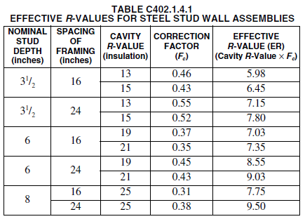
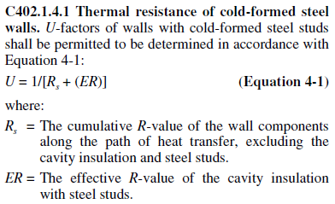
Continuous insulation is very important to thermal performance of steel framing
2015 IECC
Cavity insulation alone is a poor solution for steel framing.
The addition of R-10 CI more than doubles this wall’s insulating power
Without CI:
R-19 Cavity
R-0 CI
Effective: R-7
With CI:
R-19 Cavity
R-10 CI
Effective: R-17

Slide 9

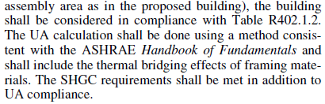
Total UA Envelope Trade-offs
Notes:
Provides a means of trading insulation amounts between roof, wall, windows, doors, floors and foundations provided the total UA of the building is no less than would be achieve using the U-factors for each assembly times the area of that assembly. This can be used, for example, to reduce wall insulation levels (e.g., remove CI) and increase foundation or roof or window or any combination of R-values elsewhere for equivalent performance (at least thermally speaking).

Slide 10
U-factor and UA-Analysis Resources
ABTG U-factor calculator
  Specifically tailored to support U-factor analysis of CI assemblies
ResCheck
  U-factor and UA analysis
ComCheck
  U-factor and UA analysis
Notes:
http://www.energycodes.gov/sites/default/files/documents/BECP_Methodology%20for%20Developing%20REScheck%20Software%20through%20Version%20443_Sept2012_v00.pdf
Rescheck methodology is explained in the above document. See Section A2.1 Wood-Frame Walls

Slide 11
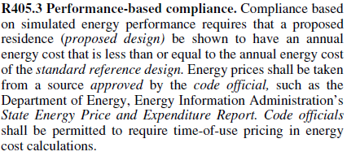
Building Performance Path
Use this approach to make full use of trade-offs or demonstrate whole-building compliance, but requires approved energy modeling (software) and comparative analysis procedures.
IECC 2012 R405.3
Notes:
Certain mandatory requirements must still be met in the performance path, thus, it is not a totally unrestricted pathway to compliance.

Slide 12
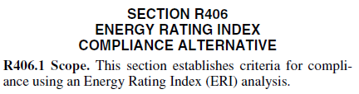
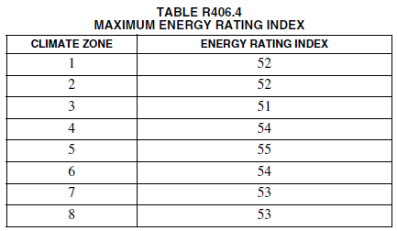
Energy Rating Index (ERI) Path
New in 2015 IECC
The ERI is a score of 100 (equivalent to the 2006 IECC) to 0 (no net energy use). Same as HERs.
The ERI values in the table are evaluated by DOE and others to ensure equivalency to the other compliance paths in the 2015 code.
Local amendments may attempt to raise these values to ease compliance and reduce insulation requirements
This would create a compliance advantage for the ERI path that is not equivalent to other paths.

Slide 13
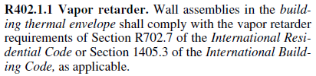
Coordinate with Building Code Vapor Retarder Requirements
Regardless of a given assembly’s compliance with the energy code, the 2015 IECC requires it to be checked for compliance with vapor control requirements in the building code.
This check is important…more later.

Slide 14
Not a fair trade: Long term benefit of CI vs. shorter term equipment efficiencies
Some builders are using the performance or ERI paths to take equipment efficiency trade-offs
  This can come at the expense of CI and long term wall performance
  Unfortunately, some federal mandates contain outdated minimum equipment efficiencies for trade-off purposes
  Because it is an issue of federal law, this can’t be dealt with through the model or local code development process.
This creates a loophole where wall CI can be traded off for unequal equipment efficiencies, reducing the overall performance of the building

Slide 15
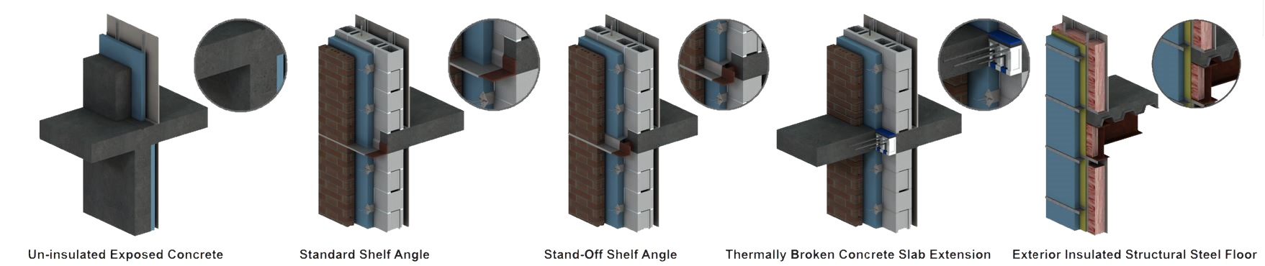
CI vs Thermal bridging: a game changer
Poor thermal bridges include:
Uninsulated slab edges or balcony projections
Concrete wall/floor intersections with no exterior insulation
Window/wall transitions (thru-wall metal flashings, etc.)
Furring and shelf angles penetrating continuous insulation.
Poor (top left) to enhanced thermal bridging details
(Source: Morrison Hershfield, SOLUTIONS, 2012, Issue 3)
Notes:
Strategic use of continuous insulation together with “smart” construction detailing can significantly reduce the effect of thermal bridges as shown above. The next slide demonstrate the impact if thermal bridges at various structural details are not mitigated.

Slide 16
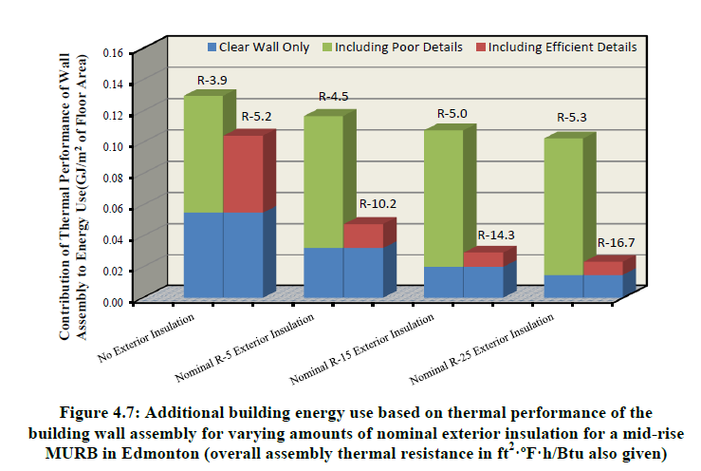
CI vs Thermal bridging: a game changer
Thermal bridging can increase heat flow up to 3x – but the energy codes do not address these details.
For additional information and design guidance refer to the Building Envelope Thermal Analysis (BETA) Guide.
Source: Cianfrone, Roppel, and Norris (2012)
Notes:
Building designers should be encouraged to address structural thermal bridges and make smart use of continuous insulation at these locations of high heat flow.

