Slide 1
Structural

Slide 2
PART 3: Building Code Compliance
Structural
  Sheathing /Wind Pressure
  Cladding Attachment
  Window Attachment
  Vinyl Siding over Foam / Wind Pressure
  Foam sheathing with PC Stucco
  Foam sheathing with Wood Shakes/Shingles
  Wall Bracing

Slide 3
Structural Code Requirements are No Different for Walls with CI
Integration with Wall Bracing (IRC R602.10)
  Must have bracing with or without CI (no difference)
Integration with framing requirements -- stud sizing, connections, wind uplift load path, etc.
  Must meet all framing requirements with or without CI (no difference)
Wind pressure resistance of exterior wall covering assemblies (IRC R703.1.2)
  All must provide wind pressure resistance
Notes:
3

Slide 4
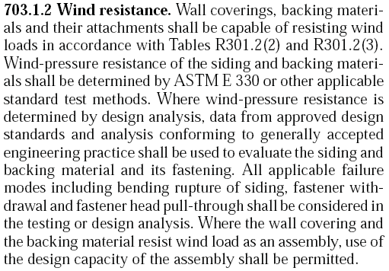
Wind Pressure Resistance
(Link to code)
NOTE: This 2009/2012 IRC code provision was proposed by ACC-FSC to ensure all sheathing materials and claddings used as wall coverings meet code
Notes:
4

Slide 5
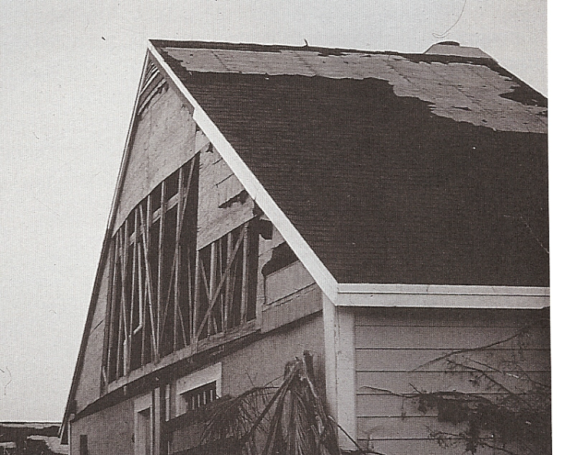
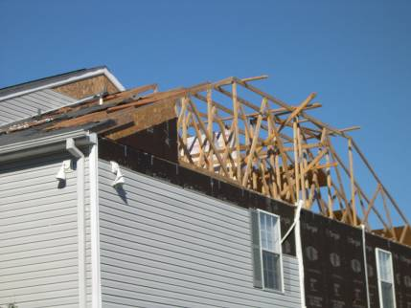
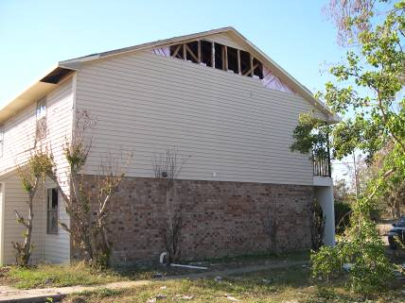
All Wall Coverings or Sheathings are Subject to Wind Damage
Wood structural panels
Fiber board
Foam sheathing
Notes:
5

Slide 6

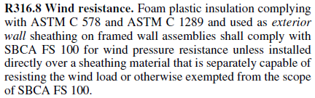
Foam Sheathing Wind Pressure Requirements
  New in IBC & IRC 2015

Slide 7
Foam Sheathing Wind Pressure Requirements
Foam sheathing must resist wind pressure as part of a wall covering assembly:
  Cladding/furring secures foam to resist negative design wind pressure
    Typical fasteners intended for temporary wind conditions
  Foam sheathing material must:
    Span between studs
    Have adequate bending strength
  Foam sheathing attachments can be designed for permanent wind load resistance
Notes:
Per IRC Section R703.1.2, foam sheathing must resist wind pressure as part of a wall covering assembly.
Cladding or furring strips secure foam to resist negative. or suction, design wind pressure.
Typical foam sheathing fasteners used during installation are intended for temporary wind conditions only, unless otherwise designed to resist full wind load.
Foam sheathing material must
Span between studs, when not used as “over-sheathing”.
It also must have adequate bending strength to resist positive and negative design wind pressure.
The IBC is not as specific, but does require exterior walls to be designed to resist the required loads, including wind loads.
7

Slide 8

Code Compliance Resources
(wind pressure)
ANSI/SBCA/FS 100–2012
  Provides path for code compliance and building official approval
  Referenced in 2015 IBC and IRC
    Exception: Foam sheathing does not need to comply if used as oversheathing over structural sheathing
Notes:
For more information on wind pressure code compliance,
See ANSI/SBCA/FS 100–2012, “Standard Requirements for Wind Pressure Resistance of Foam Plastic Insulating Sheathing Used in Exterior Wall Covering Assemblies,” which is available at sbcindustry.com/fs100.php and has been adopted into the 2015 IBC.
8

Slide 9
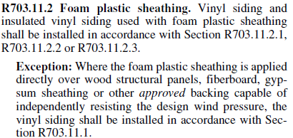
Vinyl Siding Over Foam Sheathing (wind pressure)
  IRC 2009/2012/2015:
Link to code
Notes:
Except under low wind load conditions or the oversheathing exception above, vinyl siding wind pressure ratings are required to be adjusted when applied over foam sheathing. This may limit product choices in higher wind zones and/or require use of premium vinyl siding products, but the performance will be superior to that of typical vinyl siding installations over other sheathing types.
9

Slide 10
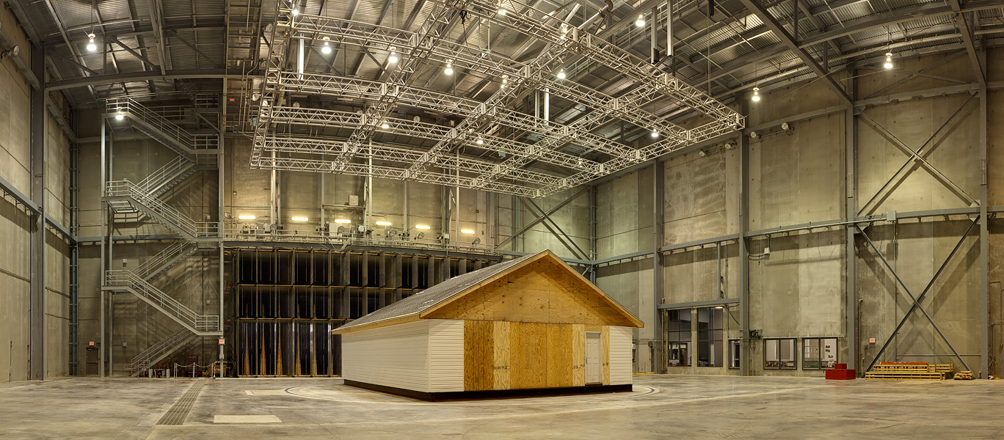
DOE/IBHS/ACC-FSC/NAHB-RC /VSI
Whole Building Wind Tunnel Test
Notes:
10

Slide 11
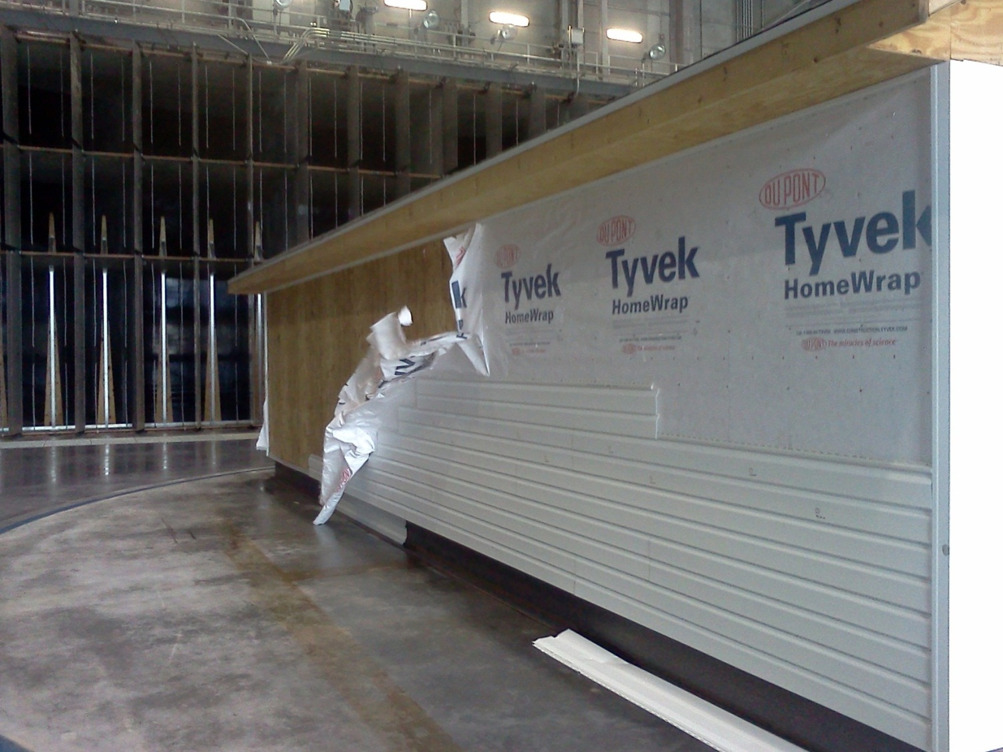
Results – OSB/wrap/vinyl
Notes:
Typical building wraps are not a very wind resistant WRB choice. Building protection can be compromised during construction or as a result of siding damage during severe wind events.
11

Slide 12
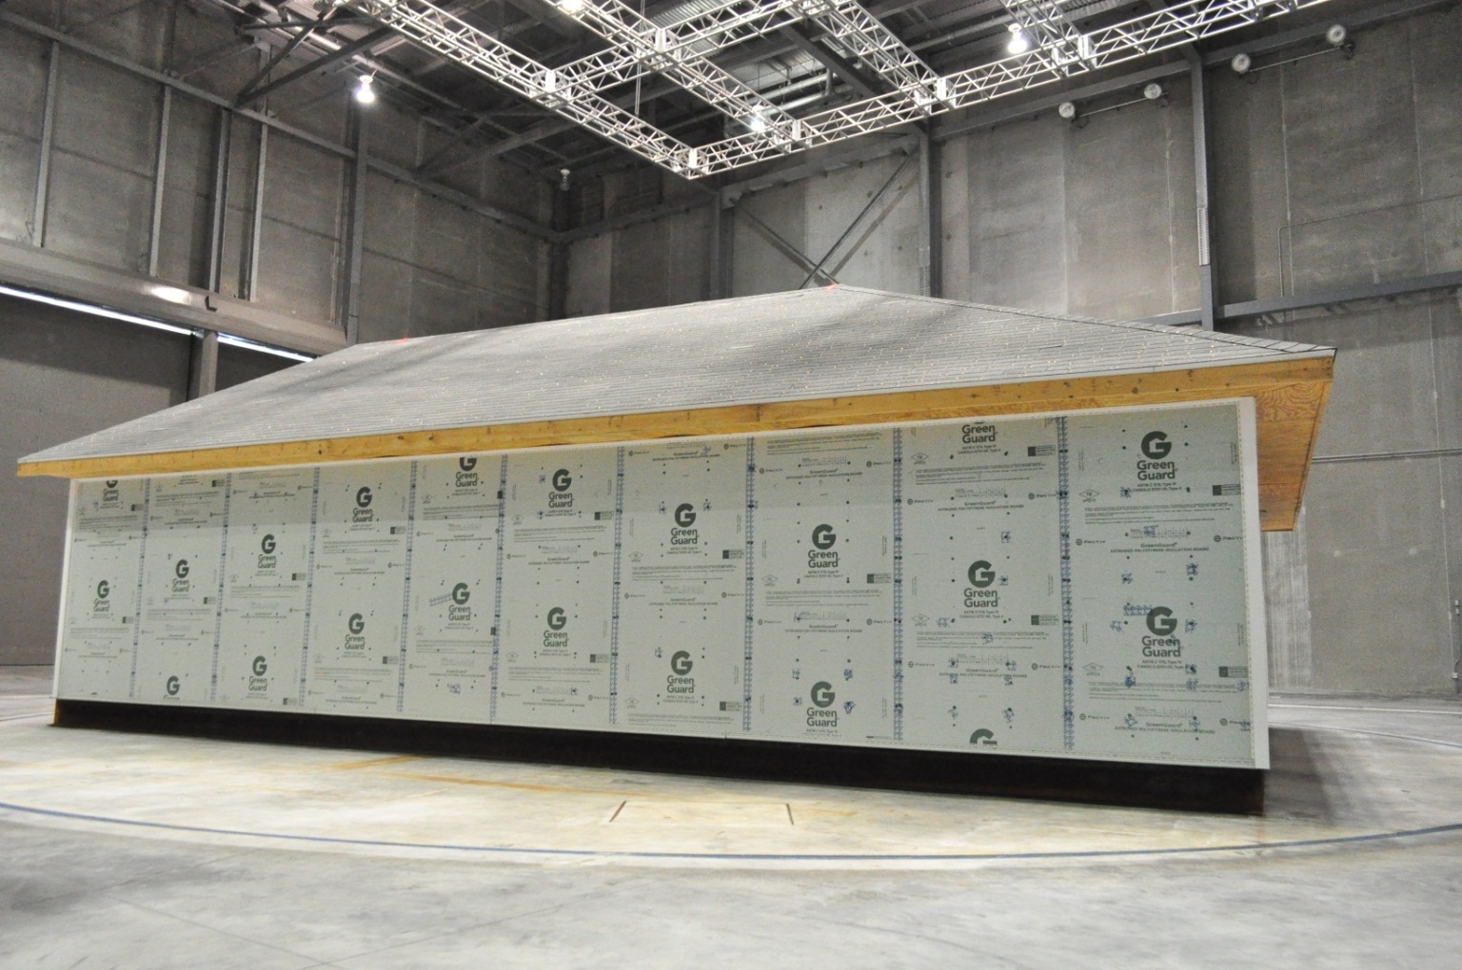
Results – CI/vinyl (vinyl removed)
Notes:
Foam sheathing and taped WRB joints survived exposure to hurricane force winds with no damage even with siding removed
12

Slide 13
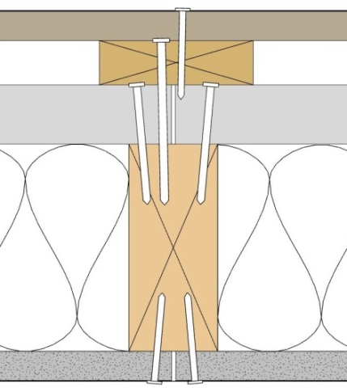
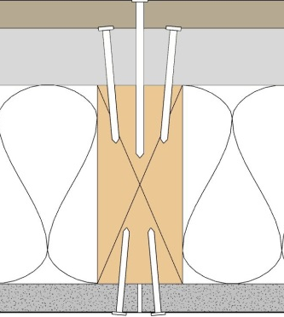
Cladding Attachment
ACC-FSC, NYSERDA, DOE and SFA funded research
  Adopted in NY energy code (effective Dec 2010)
  Referenced in IBC Section 2603.11 (masonry/concrete) and 2603.12 (steel framing)
  Referenced in IRC Section 703.15 (wood framing); R703.16 (steel framing); R703.17 (concrete/masonry)
TER No. 1006-01
Code compliant guidance for generic applications
  Must be minimum 15 psi compressive strength FPIS per ASTM standards for XPS, EPS, or Polyiso
Proprietary fasteners or connectors and cladding/CI systems also available
Siding fastener embedment must be maintained with all thicknesses of foam
Also refer to siding manufacturer’s installation requirements
(a)
(e)
(b)
(c)
(d)
(a)
(e)
(c)
(d)
cladding (b) furring or WSP (optional)
(c) FPIS (d) wall framing (e) fastener
Notes:
13

Slide 14
Flanged Window Attachment
TER No. 1304-01
Attachments for typical window flanges placed over FPIS up to 2” thick
  Must be minimum 15psi compressive strength foam (XPS, EPS, or Polyiso meeting ASTM standards).
See TER No. 1205-05 for details with window bucks to allow unlimited foam thickness.

Slide 15
Foam Sheathing and PC Stucco
IBC 2510.6 & IRC R703.6.3
  Exception Statement from IRC
    Exception: Where the water-resistive barrier that is applied over wood-based sheathing has a water resistance equal to or greater than that of 60-minute Grade D paper and is separated from the stucco by an intervening, substantially nonwater-absorbing layer or designed drainage space.

Slide 16
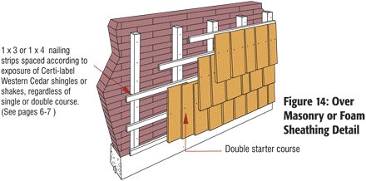
Foam Sheathing and Wood Shakes/Shingles
IRC R703.5
  Requires double layer lattice of furring
  Not based on evidence or science
BC Cedar Shake & Shingle Guide
FSC Case Study Report

Slide 17
Wall Bracing
Many building design factors impact wall bracing decisions which impact sheathing/insulation decisions.
Refer to ACC-FSC Wall Bracing Guide (http://fsc.americanchemistry.com)
Code-compliant bracing methods include:
  Use of foam over continuous sheathing (e.g., OSB, structural fiberboard, etc.)
  Use of foam between and/or over intermittent braced wall panels (e.g. OSB, let-in, structural fiberboard, hardboard, etc.)
All bracing methods have limitations, advantages, and disadvantages (not unique to CI applications)
Notes:
17

Slide 18
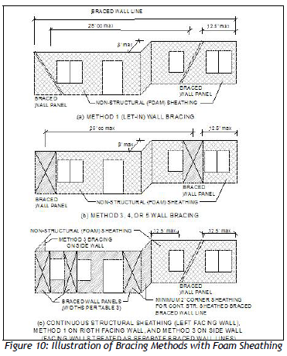
Wall bracing – integration with FPIS
Notes:
Foam sheathing only with let-in bracing
Foam sheathing over corner panels and thicker foam sheathing in between for uniform wall thickness (“footnote h” wall)
Oversheathing = continuous insulation over continuous wood structural panel sheathing (or proprietary structural insulated panel)

