Slide 1
Building science

Slide 2
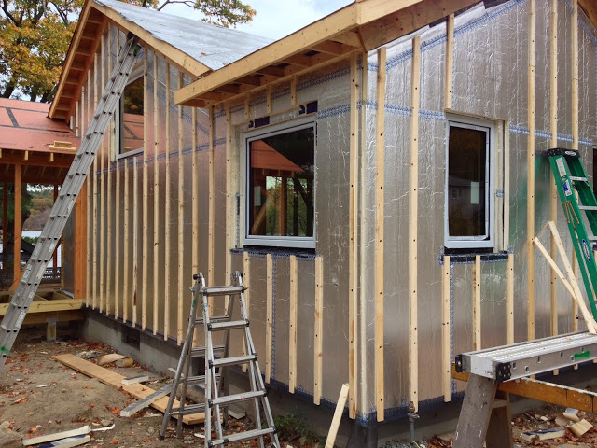
Building Code Compliance – Building Science
Building Science
Water-Resistive Barriers (WRB)
Air Barriers (AB)
Vapor Retarders (VR)
Moisture Control
Notes:
This leads us into Building Code Compliance and Building Science. In particular, we’ll examine
Water-resistive barriers,
Air barriers,
Vapor retarders, and
Moisture control.
Image source: http://www.prettygoodlakehouse.com/2013_10_01_archive.html

Slide 3
Water Resistive Barrier (WRB)
Only applies to approved products
Installation requires use of approved flashing tapes
Quality installations are durable
Rigorous code acceptance testing
Field studies confirm (after 15 years of service)
More wind resistant than membrane/wrap

Slide 4
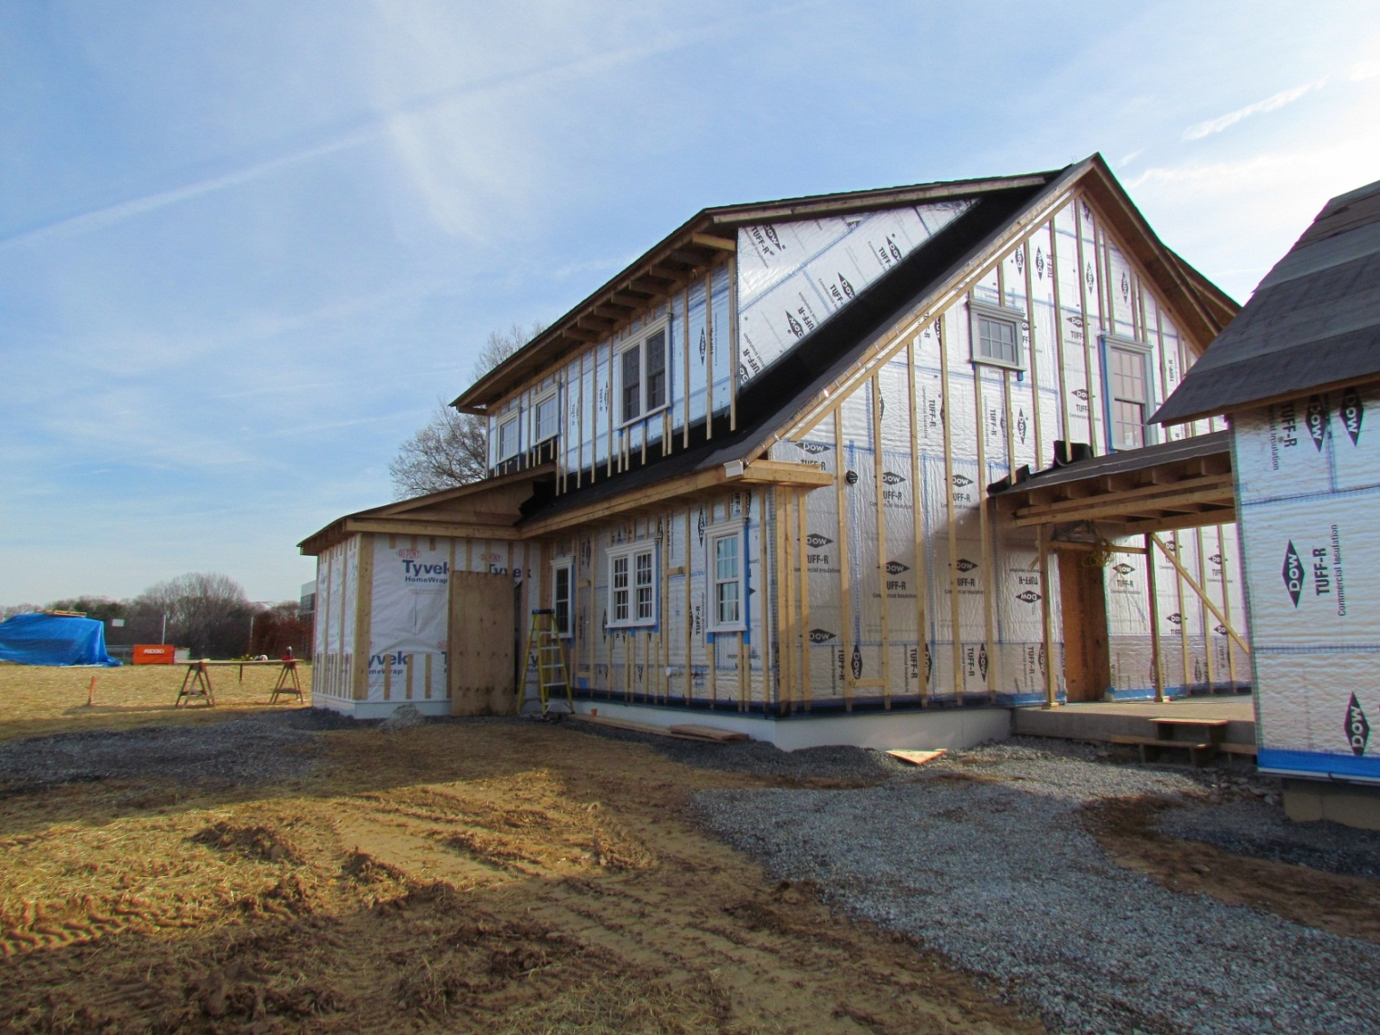
WRB Installation (NIST Net-Zero Energy House / BSC / ARES)
Building Science Corporation

Slide 5
Water Resistive Barrier
Rain water is the main concern with moisture for all types of walls (with or without CI)
WRB equivalence of taped FPIS
Confirmed by code compliance research report as defined by the IBC Sections 104.11.1 Research reports and 1703.4.2 Research reports.
ABTG RR XXXX (not yet online)
TER No. 1410-05 (not yet online)
Foam sheathing products + flashing tapes = WRB
Notes:
Water-resistive barriers are required on all exterior walls, regardless of cladding type.
The code requires the use of No. 15 asphalt felt or a material with equivalent performance.
Rain water is the main concern with moisture for all types of walls, both with and without continuous insulation.
IRC Section R703.2 and IBC Section 1404.2 contain similar language.

Slide 6

Water Resistive Barrier
Meets energy code and WRB requirements (
Designer/Builder must consider cost of WRB and insulation strategy
IRC R703.2
WRB required on essentially all exterior walls (regardless of cladding type)
Code requires #15 asphalt felt or equal
Notes:
Water-resistive barriers are required on all exterior walls, regardless of cladding type.
The code requires the use of No. 15 asphalt felt or a material with equivalent performance.
Rain water is the main concern with moisture for all types of walls, both with and without continuous insulation.
IRC Section R703.2 and IBC Section 1404.2 contain similar language.

Slide 7
Water Resistive Barrier
WRB equivalence is usually confirmed by a code evaluation service such as ICC-ES, IAPMO, ATI, or DrJ Engineering
Several foam sheathing products + flashing tapes = WRB
Meets energy code and WRB requirements in one package
Designer/Builder must consider combined cost of WRB and insulation strategy when comparing options

Slide 8
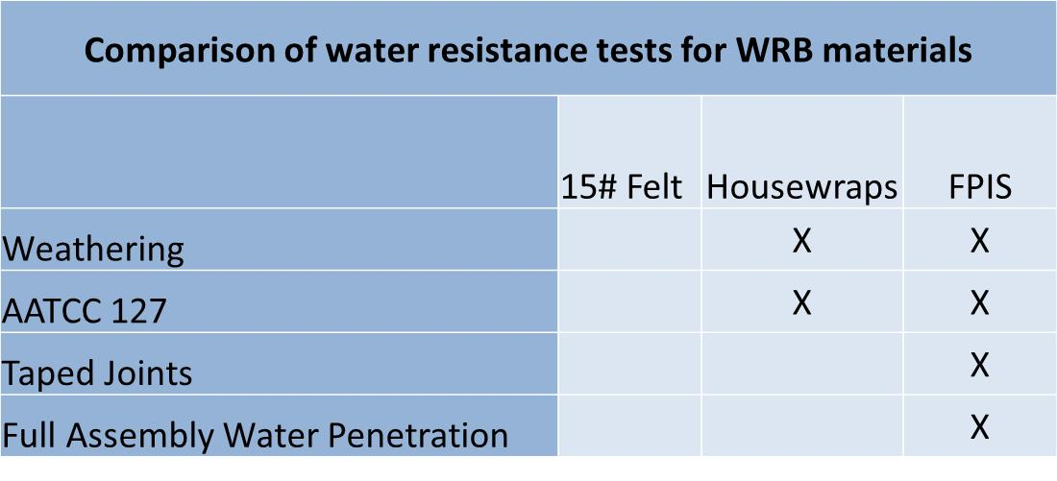
WRB Performance Testing Comparison
Foam sheathing is tested to a full assembly water penetration test. Other common products such as wraps and 15# felt are not. Taped joints and foam sheathing are also subjected to accelerated weathering and then water resistance.

Slide 9
Foam sheathing was not the cause of EIFS moisture problems!
“Doesn’t foam sheathing trap water or cause condensation in walls with vapor retarder on the outside of a wall?”
There remain many attempts to make a comparison with non-drainable (barrier) EIFS purely on the basis that EIFS contains foam sheathing.

Slide 10
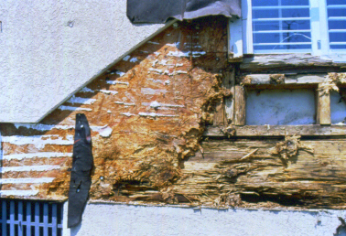
Past EIFS problems are misapplied to Continuous Insulation
Problems with EIFS were associated with:
No drainage of cladding (barrier cladding system)
No water resistive barrier layer (relied solely on face sealing or caulking of EIFS finish to windows, doors, etc.)
Face sealing (caulking) was typically not done or done incorrectly
Leaky window units were used
Roof/wall flashing was not installed or improperly installed
Sometimes used inappropriately with interior vapor barrier (poly) in mix/warm/humid climates
THESE PAST PROBLEMS WITH EIFS HAVE ALL BEEN ADDDRESSED IN MODERN BUILDING CODES
Notes:
Source: IBHS Building Safety article
10

Slide 11
WRB Addresses the “H₂0 Fear”
Fearing water is a good thing – if it leads us to follow the code and WRB manufacturer’s installation instructions carefully.
A properly installed WRB system using an approved material is critical to building durability.
FPIS is a solution:
Many FPIS brands are part of approved WRB systems (TER No. 1410-05)
If the FPIS is not approved as a WRB and installed accordingly, then a separate WRB material layer is needed.

Slide 12
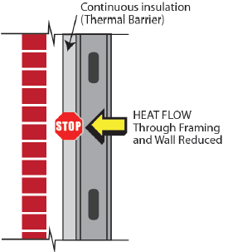
Foam sheathing creates a warm, breathable envelope assembly
In cold climates, CI prevents condensation inside walls by keeping the wall warmer than dew point temperature
Non-insulated sheathings result in colder walls with greater condensation potential (particularly for low-perm non-insulated sheathings)
Foam sheathing walls can be designed to breathe (dry) to the interior with proper interior vapor retarder selection to provide a safety factor against uncertain or incidental sources of water intrusion.
Cladding
Framing
Cold
Warm
Notes:
Continuous insulation helps
Prevent condensation from forming inside walls by keeping them warm and above the dew point temperature.
Non-insulated sheathings result in colder walls with greater condensation potential. This is particularly the case for low-perm non-insulated sheathings.
12

Slide 13

Proper Use of VR with Foam Suppresses Condensation & Promotes Drying
2015 IRC/IBC have vapor retarder options for use with CI depending on climate and R-value
In hot/humid regions (Zones 1 and 2) it is better to have low perm on exterior side of wall with drying to the interior

Slide 14
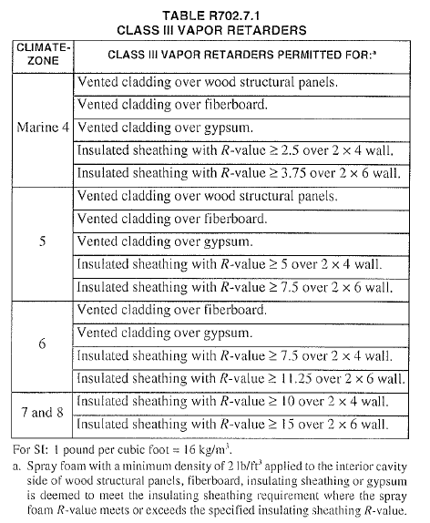
“Warm Wall” Class III VR Requirements and Foam Sheathing R-value
Link to code
Notes:
Table R702.7.1 lists the conditions for Class III vapor retarders. IBC Section 1405.3.1 is similar.

Slide 15
Air Barriers
Air Barrier (AB)
Requirements for air barriers are addressed in the energy code, not the building code (see Module 8).
Most foam sheathing products with properly sealed joints meet air-barrier requirements (air permeability test)
Check with manufacturer
Air barriers are also important to the building code’s interest in durability and moisture control because they help prevent moist air from leaking into and condensing in assemblies.

