Slide 1
Installation details

Slide 2
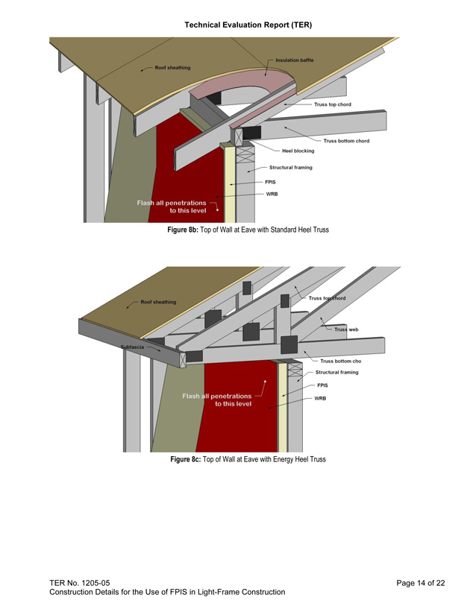
Installation Details for Code Compliance
Must be installed per manufacturer’s instructions
Architects can provide construction details for plan approval
  TER No. 1205-05
  Provides path for code compliance and approval
  DXF files also available. Contact Staff.
Notes:
This report provides a clear path for code compliance and building official approval on the topic of foam sheathing installation detailing.
Files of the details are also available.
2

Slide 3
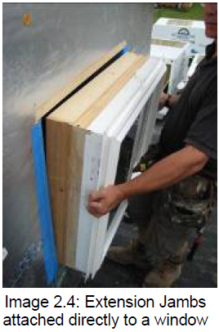
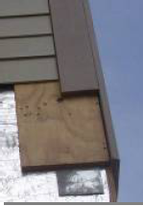
Window and Siding Installation Details with Thick Foam
Detailing of CI wall assemblies with 6"+ of foam
  DOE’s Building America Program
  Alaska REMOTE house
  Passivhaus design
  Net-zero buildings
  TER No. 1304-01 (limited to 2” FPIS)
Notes:
Various manufacturers have developed installation instructions and detailing specific to their product lines.
There is great experience and information on successful detailing of continuous insulation wall assemblies with as much as 6 inches or more of foam.
Two examples are:
DOE’s Building America Program, and the
Alaska REMOTE house.
Links:
Building America http://www1.eere.energy.gov/buildings/residential/ba_research.html
3

Slide 4
Detailing Tips
If no more than 2” of CI on a 2x4 wall
  Total wall thickness for window and door frames is no different than 2x6 construction
  3.5” + 2” = 5.5”
For thicker applications of CI:
  May need to “box out” window and door openings
  Corner/trim details required
  Furring can provide siding attachment and positive securement
Notes:
If no more than 2 inches of continuous insulation is used on a 2x4 wall,
Then the total wall thickness for window and door frames is no different than it is for 2x6 construction.
For example, 3.5 inches plus 2 inches equals 5.5 inches.
4

